Slide 1
Genetic Testing Presentation
Human Genome Analysis: Spring 2020
Nate Haywood

Slide 2
23&Me Technology
Genotyping: Process of determining which genetic variants an individual has
Predicated on already having established the effects of genetic variants for a specific gene
Still more cost effective to analyze specific regions

Slide 3
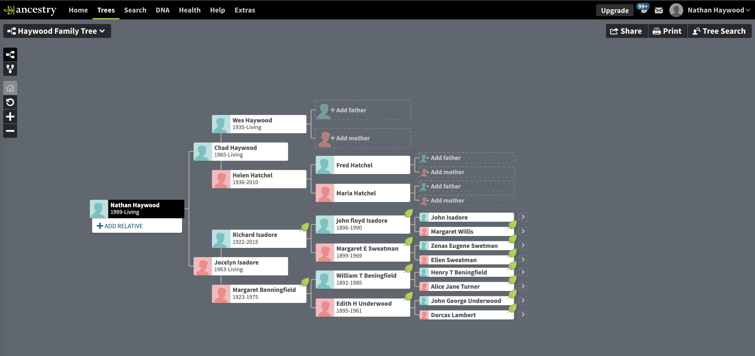
Family History

Slide 4
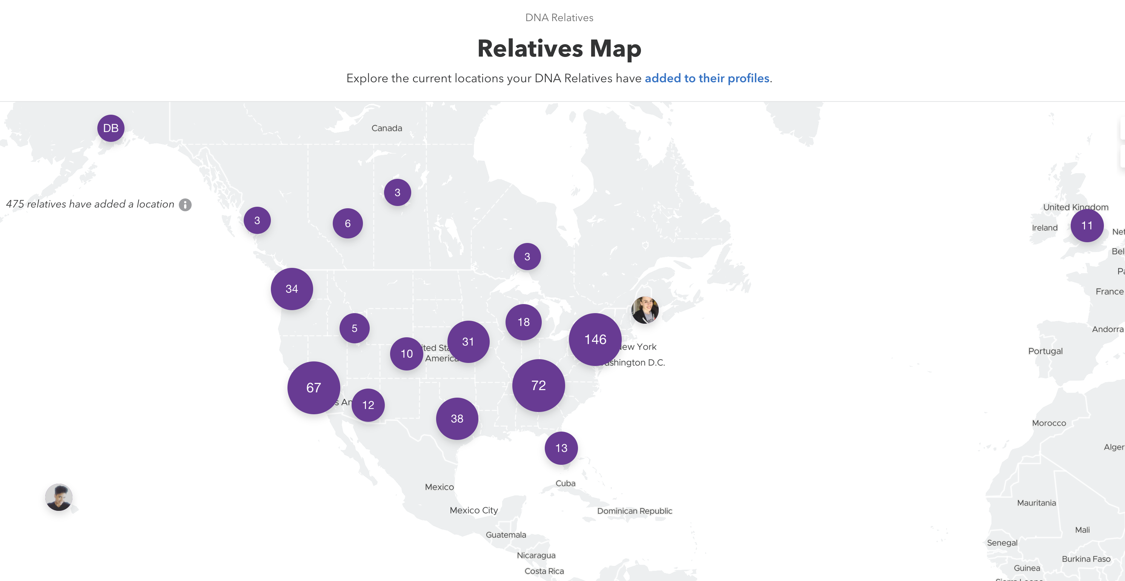
23&me Relative Matches
Closest Relative Match: 2nd or 3rd Cousin
1.3% DNA / 7 Segments
All other 1400 Matches: 4th Cousin or more removed
>0.5% DNA / 4 Segments

Slide 5
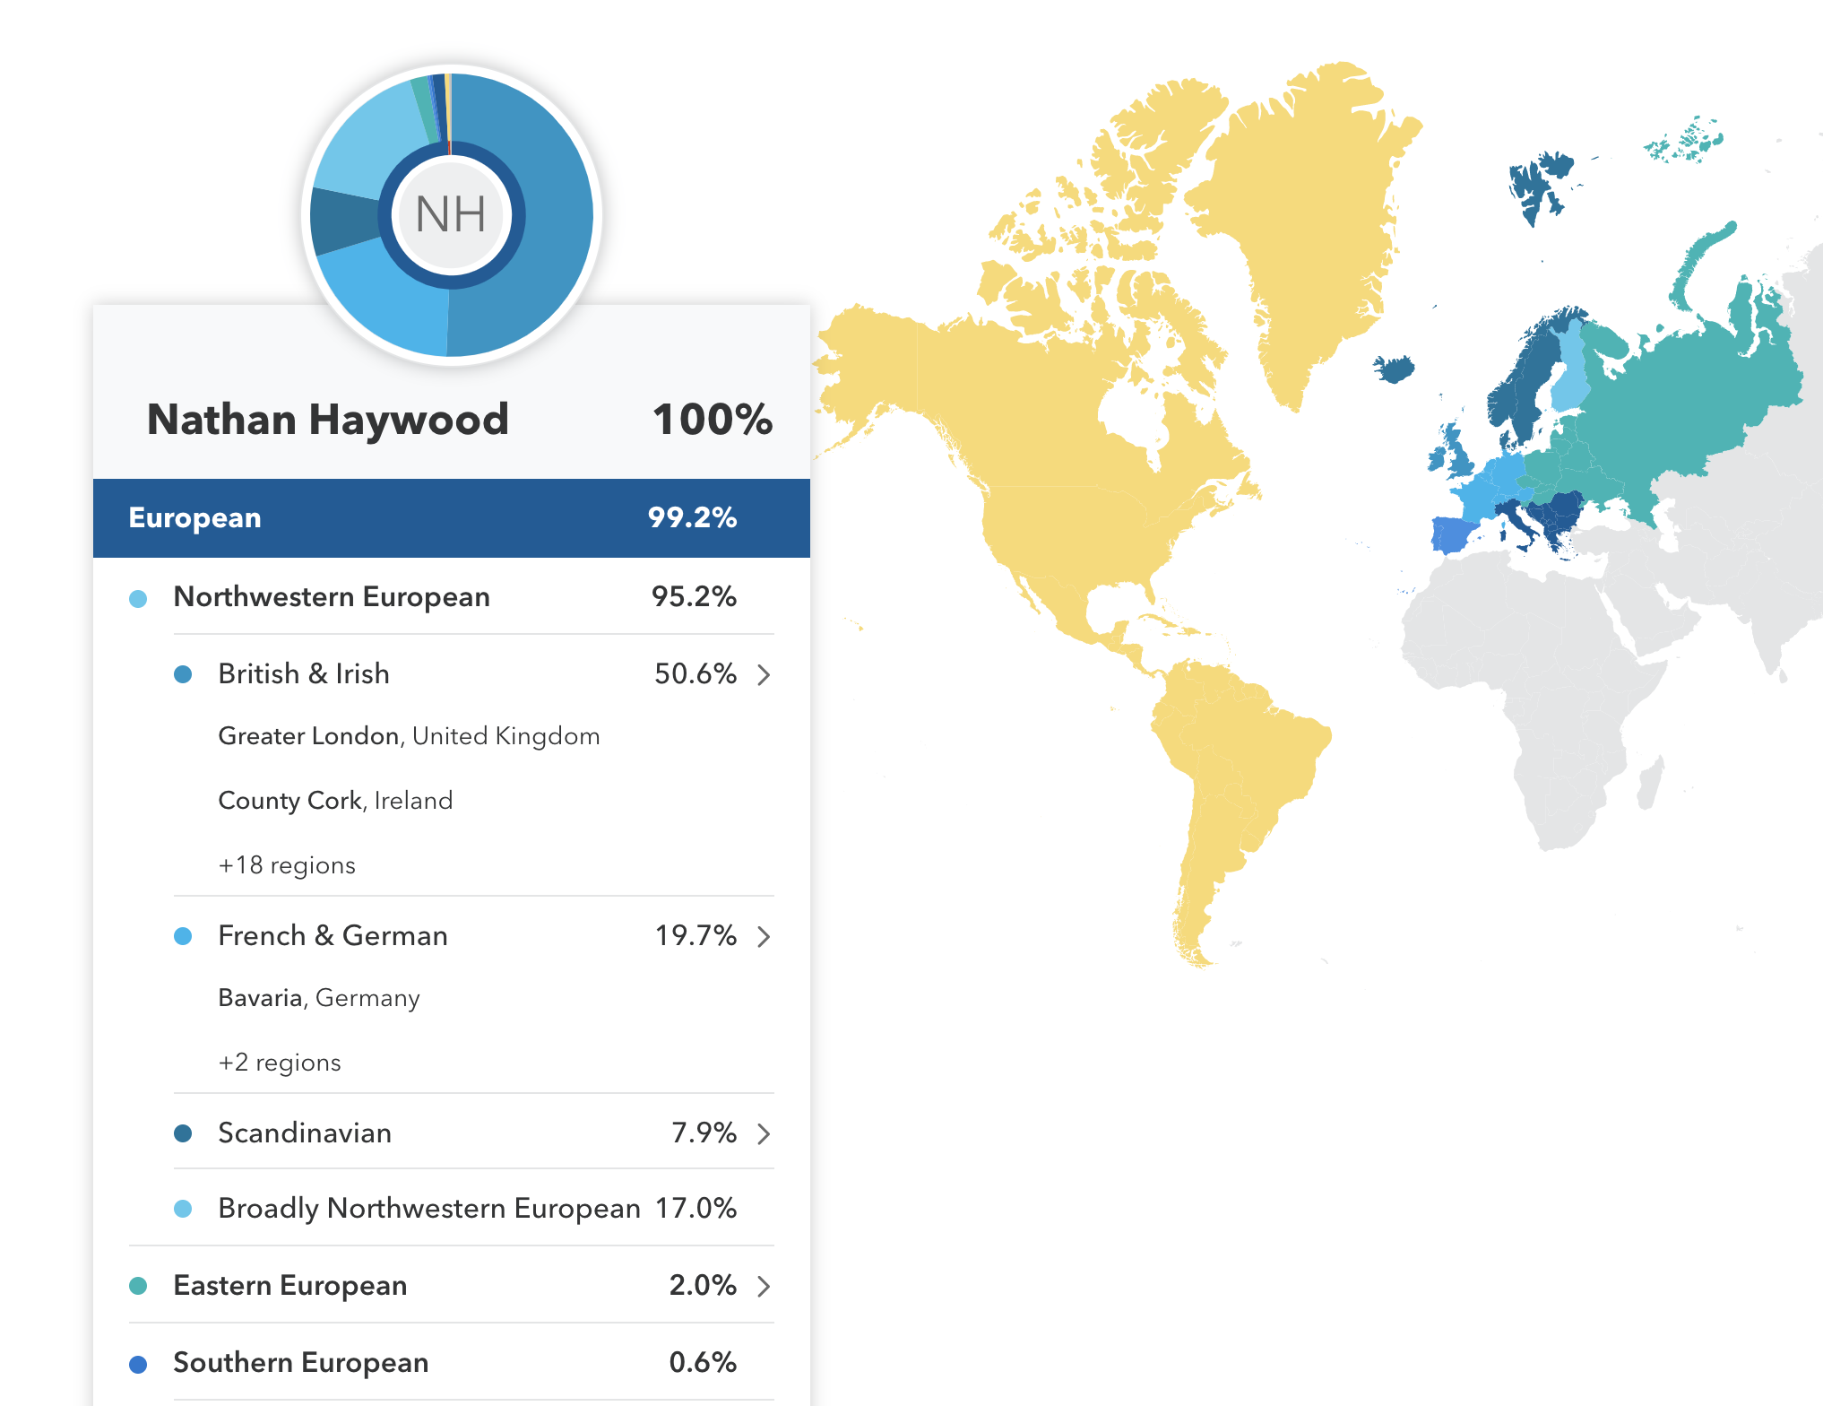
ethnicity
Mom’s Side: British
Family living in England
Dad’s Side: German / French
No known family living in German

Slide 6
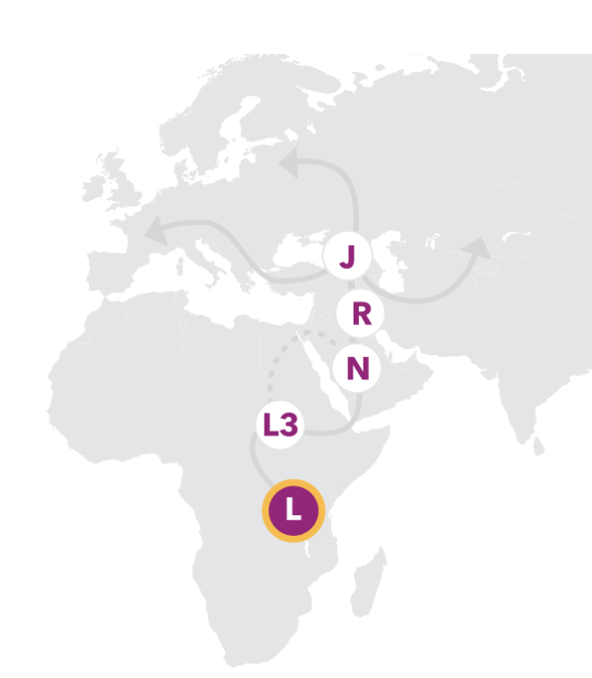
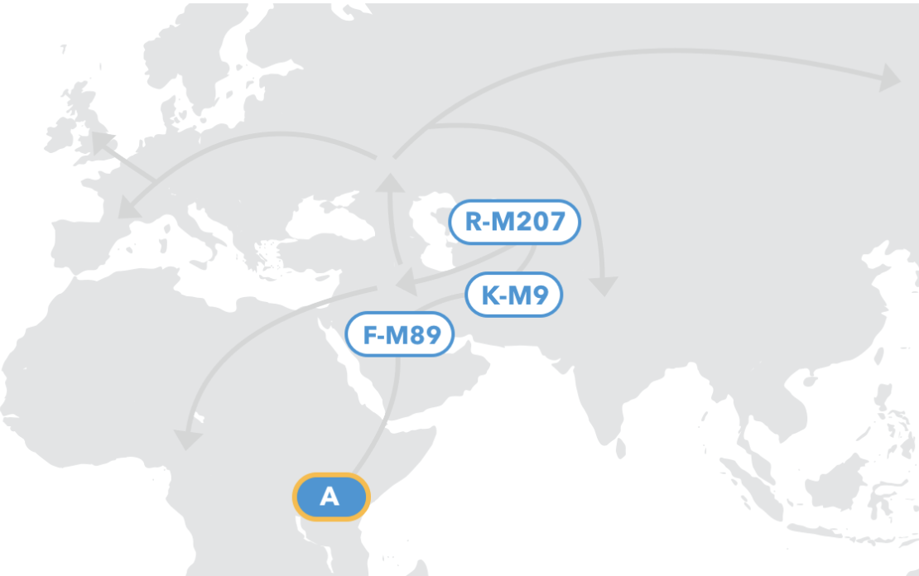
Long Term Family History
Maternal Side:
Mitochondrially Tested
J1c3 haplogroup
King Richard III
Paternal Side:
Y Chromosome lineage
R-Z156 haplogroup
King Louis XVI

Slide 7
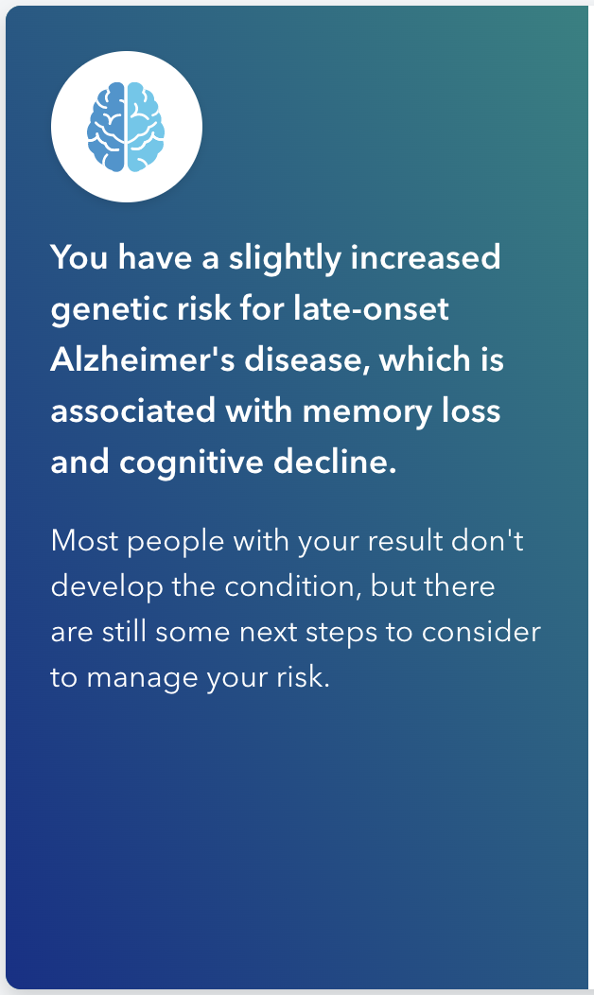
Medical Implications
Disease Predispositions:
Age related macular degeneration variant: slight increased risk
Late onset Alzheimer's variant: slight increased risk
Carrier Status:
No variants detected

Slide 8
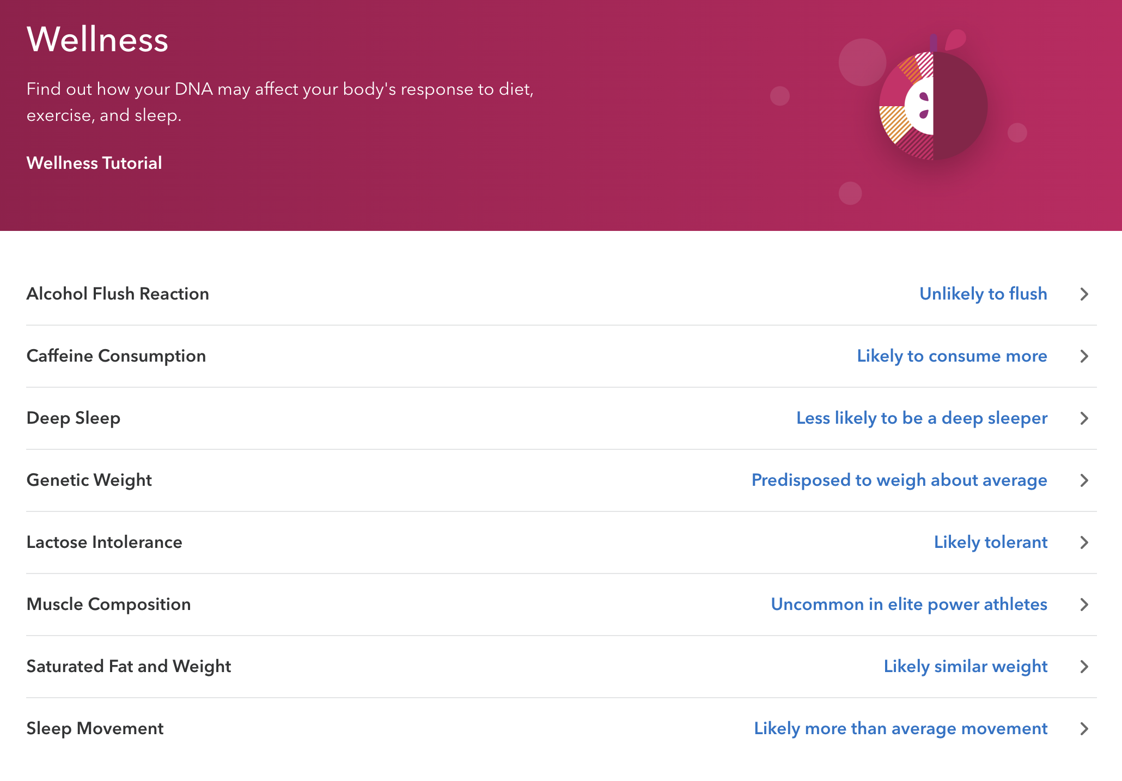
Interesting Findings
Traits:
Musical Pitch: Unlikely to be able to match
Fear of Public Speaking: More likely
Fear of Heights: Less likely
Wake up Time: 9:00 AM
Eye color: Green / Blue

Slide 9
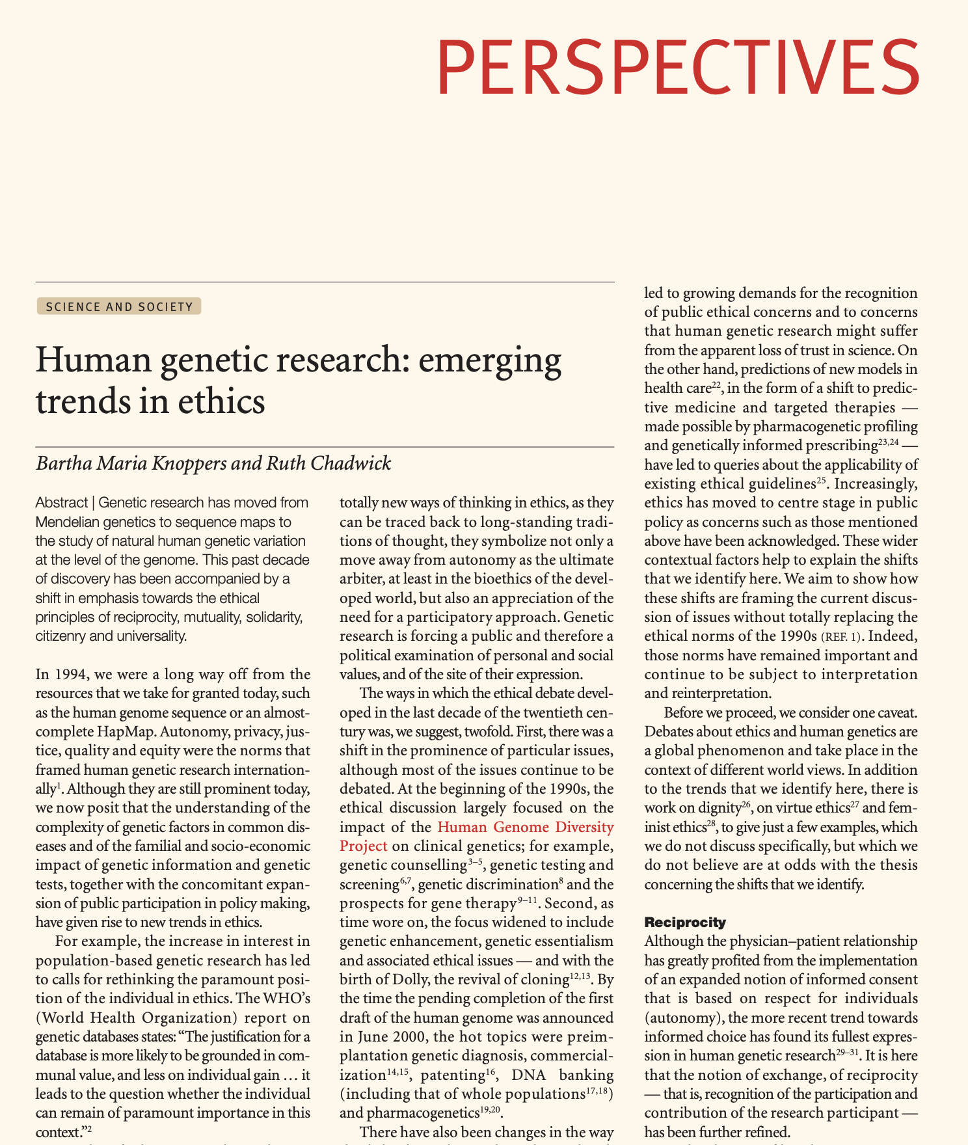
Next Steps
Not overly interested in continuing to pursue ancestry information
I don’t think that more genetic testing is necessary
Decisions on making my data available / joining research efforts

Slide 10
Sources
23&Me.com
Ancestery.com
Knoppers, Bartha Maria, and Ruth Chadwick. “Human Genetic Research: Emerging Trends in Ethics,” 2005, 5.

